Slide 1
Swin Transformers Hierarchical Vision Transformer using Shifted Windows Ze Liu, Yutong Lin, Yue Cao, Han Hu, Yixuan Wei Zheng Zhang, Stephen Lin, Baining Guo Microsoft Research Asia
Deep Learning and its applications to Signal and Image Processing and Analysis
Paper Presentation
Under the supervision of Prof. Tammy Riklin Raviv
Students:
Daniel Manor, Lior Yaacov

Slide 2










Agenda
1
Introduction
Attention, Transformers and ViTs explained
2
Challenges
Transformers challenges in vision tasks
3
Related Work
Method
Swin Transformer method explained
4
Models
Experiments
Validating Swin Transformer’s Performance
5
Conclusions
Summarizing and Future Directions

Slide 3



Opening
Leverage the advantages of transformer architecture to tackle a variety of computer vision tasks, addressing complex and non-trivial challenges effectively.
Motivation
Problem Statement
Solution
Previous attempts to adapt transformers for vision tasks, like in ViT*, struggle with high computational costs and scalability issues, making them inefficient for handling high-resolution images and capturing both local and global features.
A hierarchical architecture with shifted windows efficiently captures both local and global features while significantly reducing computational costs for high-resolution vision tasks.
* AN IMAGE IS WORTH 16X16 WORDS: TRANSFORMERS FOR IMAGE RECOGNITION AT SCALE, Alexey Dosovitskiy et al.
Notes:
Swin Transformer paper is about building a general-purpose transformer for vision tasks.
The motivation is to leverage Transformers power and success in language tasks to vision tasks.
However, language and text are different from each other in some ways that leads to challenges in adopting the existing architecture.
For that, the Swin Transformer utilizes some special methods that overcome these issues.

Slide 4

What are SWIN Transformers?
SWIN (Shifted Window) Transformers are a type of Vision Transformer (ViT) designed for computer vision tasks.
Developed by Microsoft Research.
Addresses limitations of standard ViTs by introducing hierarchical feature maps and shifted windows.

Slide 5

CNNs: Foundations of Modern Vision Tasks
Early Approaches: Handcrafted features and classical machine learning methods.
Rise of CNNs: Revolutionized image processing with layers mimicking human visual perception.
Key Vision Tasks:
Image Classification: ResNet, VGG..
Object Detection: YOLO, Faster R-CNN..
Semantic Segmentation: U-Net, DeepLab...
Advantages of CNNs: Spatial hierarchies, local receptive fields, parameter efficiency.

Slide 6


Transformers in Natural Language Processing
Transformers introduced in "Attention is All You Need" paper by Google Brain (2017).
Key Features:
Encoder-Decoder Architecture: Processes input to output sequences
Self-Attention: Each token attends to all other tokens in a sequence, capturing contextual relationships.
Multi-Head Attention: Multiple attention heads allow the model to focus on different parts of the sequence simultaneously.

Slide 7
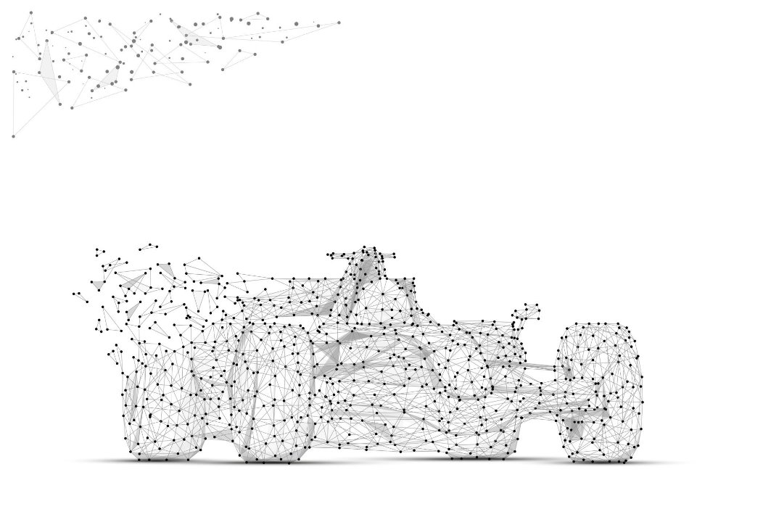
Evolution from NLP to Vision Tasks
Inspiration from NLP Success: Transformers' ability to handle long-range dependencies and parallelize training.
Initial attempts: Directly applying Transformers to vision tasks (e.g., ViT by Dosovitskiy et al. 2020*).
* AN IMAGE IS WORTH 16X16 WORDS: TRANSFORMERS FOR IMAGE RECOGNITION AT SCALE, Alexey Dosovitskiy et al.

Slide 8
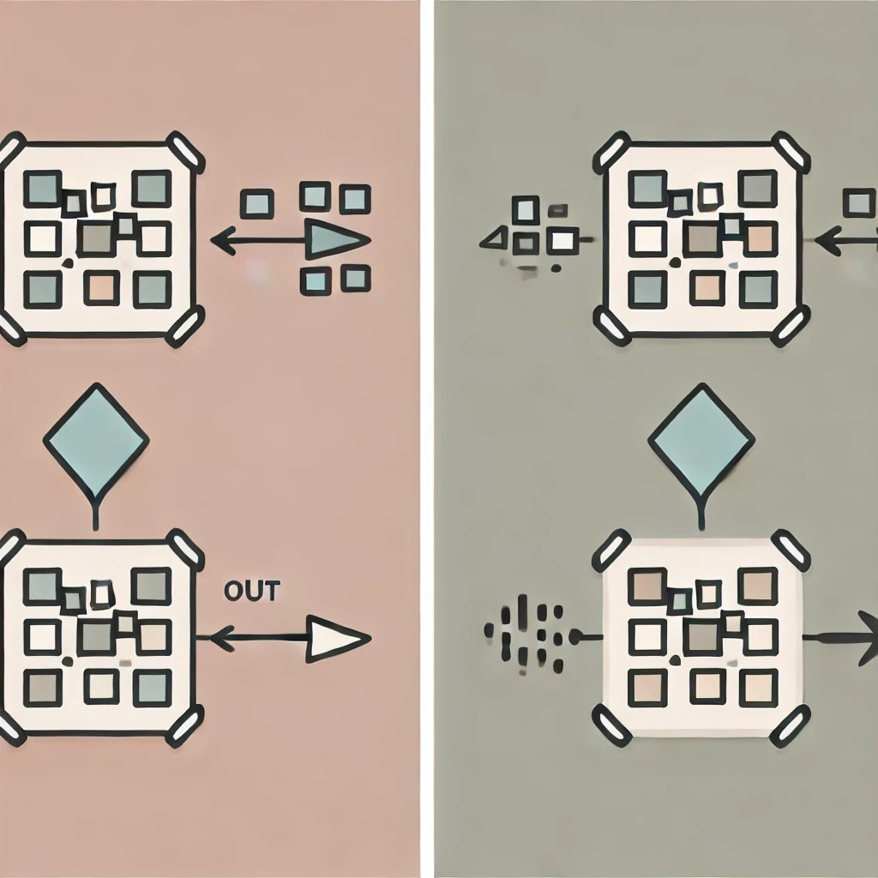
Vision Transformers (ViT)
Concept: Treats image patches as sequence tokens, similar to words in a text sequence.
How ViT Works:
Image Patches
Embedding
Model
Output

Slide 9
Vision Transformers (ViT)
Challenges of ViT:
High Computational Cost
Lack of Inductive Biases
Data Efficiency

Slide 10
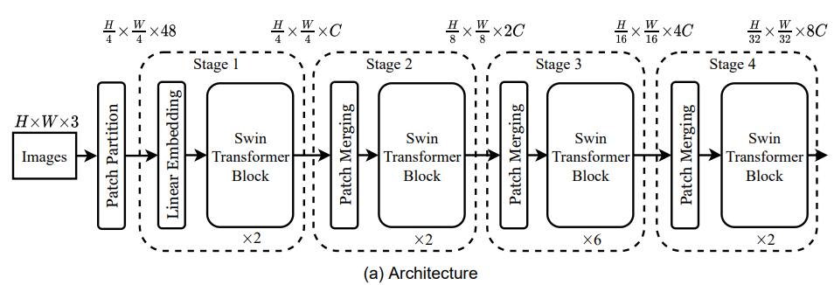
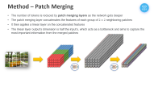

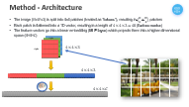
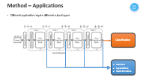
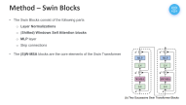
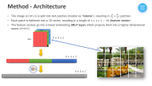
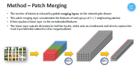
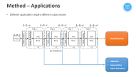
Method - Architecture
Model | C | Layer Numbers
Swin-T | 96 | 2,2,6,2
Swin-S | 96 | 2,2,18,2
Swin-B | 128 | 2,2,18,2
Swin-L | 192 | 2,2,18,2
Notes:
Patch Partition (Patch Splitting Module): splits an input RGB image into non-overlapping patches by a patch splitting module, like ViT. Each patch is treated as a “token” and its feature is set as a concatenation of the raw pixel RGB values.
Linear Embedding: A linear embedding layer is applied on this raw-valued feature to project it to an arbitrary dimension (denoted as C).
Swin Blocks: modified self-attention computation (Swin Transformer blocks) are applied on these patch tokens. The Transformer blocks maintain the number of tokens ( H/4 × W/4 ).
Patch Merging: patch merging layer concatenates the features of each group of 2 × 2 neighboring patches, and applies a linear layer on the 4C-dimensional concatenated features. This reduces the number of tokens by a multiple of 2×2 = 4 (2× downsampling of resolution), and the output dimension is set to 2C.

Slide 11


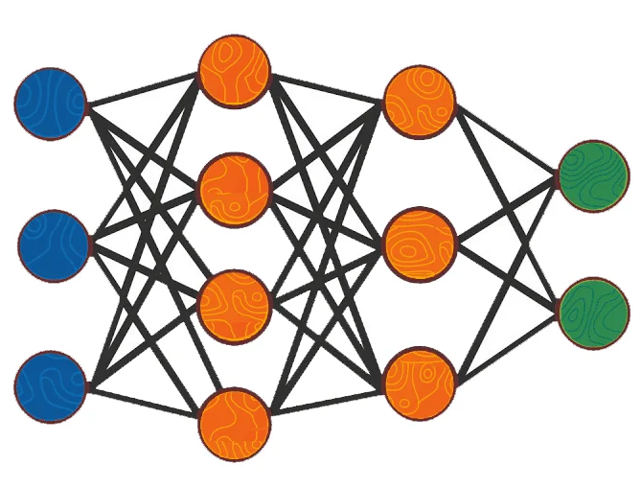
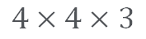
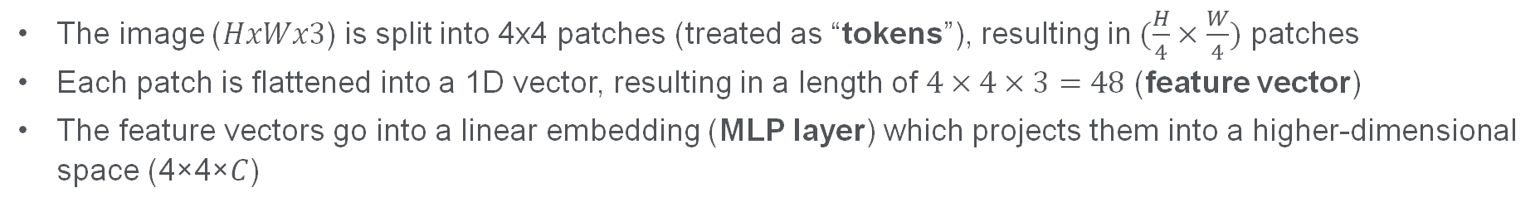
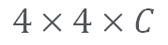
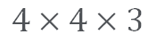
Method - Architecture
The image ($HxWx3$) is split into 4x4 patches (treated as “tokens”), resulting in $(\frac{H}{4}×\frac{W}{4})$ patches
Each patch is flattened into a 1D vector, resulting in a length of $4×4×3=48$ (feature vector)
The feature vectors go into a linear embedding (MLP layer) which projects them into a higher-dimensional space (4×4×𝐶)
4 pix
4 pix
$$4×4×3$$
$$4×4×3$$
$$4×4×C$$

Slide 12
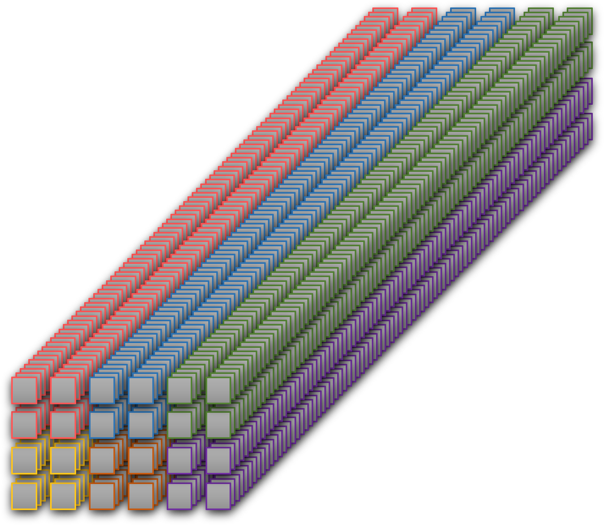
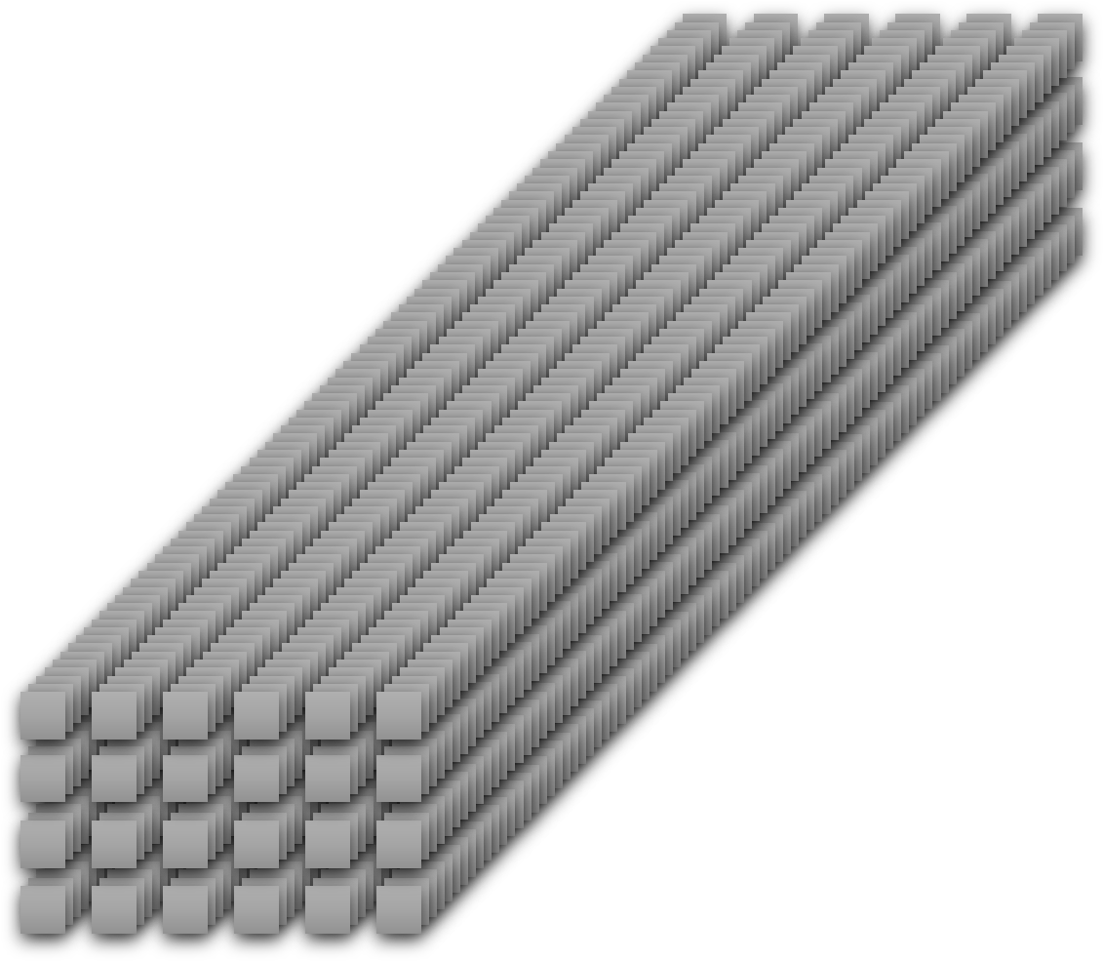
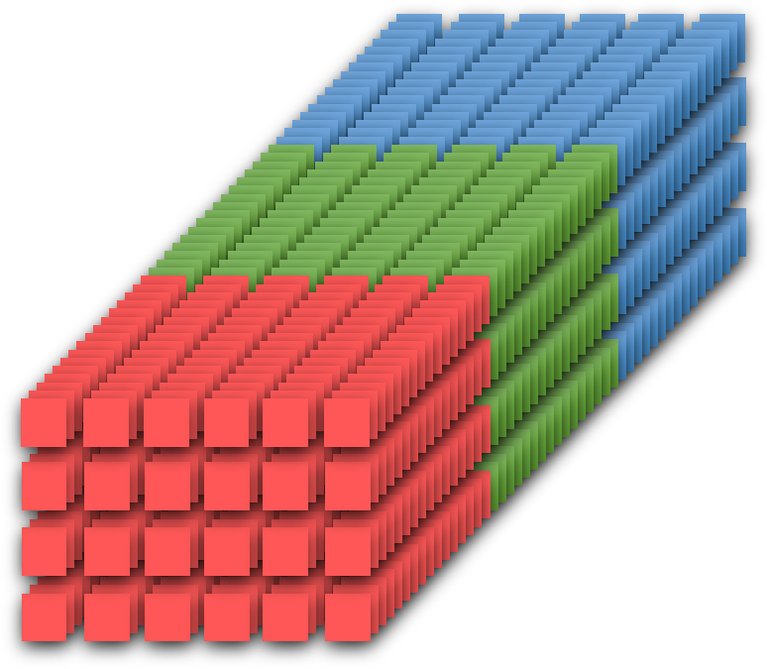
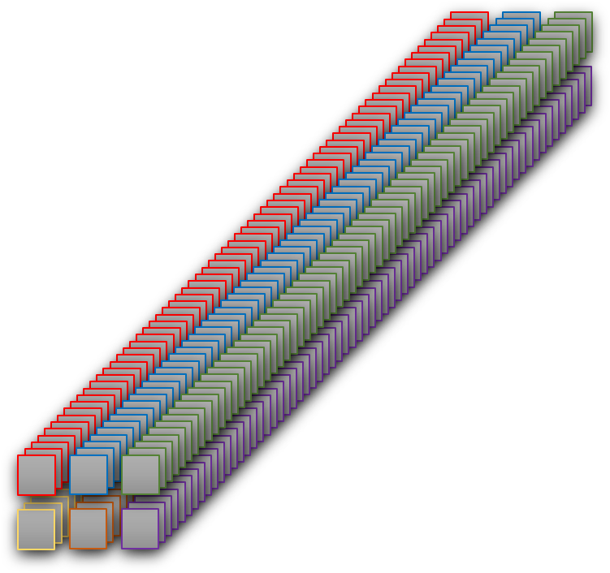
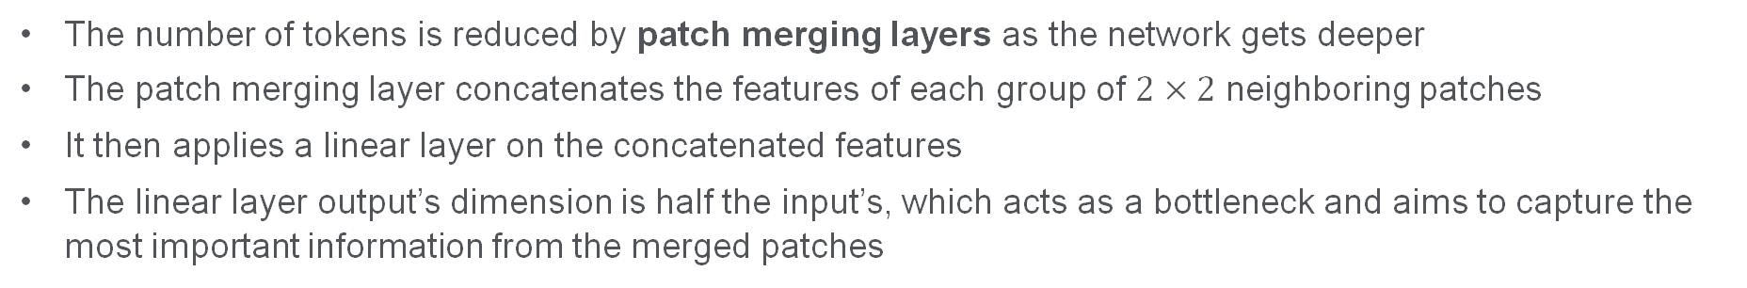
Method – Patch Merging
The number of tokens is reduced by patch merging layers as the network gets deeper
The patch merging layer concatenates the features of each group of $2×2$ neighboring patches
It then applies a linear layer on the concatenated features
The linear layer output’s dimension is half the input’s, which acts as a bottleneck and aims to capture the most important information from the merged patches
Notes:
Patch Merging
the number of tokens is reduced by patch merging layers as the network gets deeper by merging groups of $2×2$ neighboring patches and apply a linear layer on the 4C-dimensional concatenated features.
The linear layer output’s dimension is 2C, which acts as a bottleneck and aims to capture the most important information from the merged patches

Slide 13
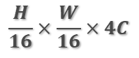
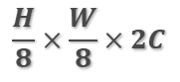
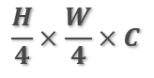
Method – Patch Merging
$$\frac{H}{4}×\frac{W}{4}×C$$
$$\frac{H}{8}×\frac{W}{8}×2C$$
$$\frac{H}{16}×\frac{W}{16}×4C$$
 | JLM

Slide 14
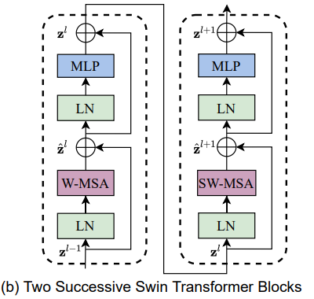
Method – Swin Blocks
The Swin Blocks consist of the following parts:
Layer Normalizations
(Shifted) Windows Self Attention blocks
MLP layer
Skip connections
The (S)W-MSA blocks are the core elements of the Swin Transformer
Notes:
Layer Normalization: normalize the activations (outputs) from the previous layer (subtract by the mean and divide by the STD)
W-MSE: calculating self-attention between feature in the same window.

Slide 15


Method – Swin Blocks – (S)W-MSA
MSA
Notes:
Standard ViTs compute self-attention between all patches, which results in quadratic complexity
Swin Transformer solves this by computing self-attention inside windows, which results in linear complexity
But, we might miss features that are between windows. For that, the authors propose Shifted Windows MSA, which shifts the windows to enable connections between them

Slide 16
Method – Swin Blocks – (S)W-MSA
0 | 0 | 0 | 0 | 0 | 0 | 0 | 0
0 | 0 | 0 | 0 | 0 | 0 | 0 | 0
0 | 0
0 | 0
0 | 0
0 | 0
0 | 0
0 | 0
 |  |  |  |  |  |  |  | 0 | 0 | 0 | 0
 |  |  |  |  |  |  |  | 0 | 0 | 0 | 0
 |  |  |  |  |  |  |  |  |  | 0 | 0
 |  |  |  |  |  |  |  |  |  | 0 | 0
 |  |  |  |  |  |  |  |  |  | 0 | 0
 |  |  |  |  |  |  |  |  |  | 0 | 0
 |  |  |  |  |  |  |  |  |  | 0 | 0
 |  |  |  |  |  |  |  |  |  | 0 | 0
0 | 0 |  |  |  |  |  |  |  |  | 0 | 0
0 | 0 |  |  |  |  |  |  |  |  | 0 | 0
0 | 0 | 0 | 0 | 0 | 0 | 0 | 0 | 0 | 0 | 0 | 0
0 | 0 | 0 | 0 | 0 | 0 | 0 | 0 | 0 | 0 | 0 | 0

Slide 17
Method – Swin Blocks – (S)W-MSA
A
C
D
Masked MSA
A
C
B
D
D
B
B
Masked MSA
B
D
C
Masked MSA
C
A
A
Masked MSA

Slide 18
Method – Applications
Different application require different output layers
Classification
Detection
Segmentation
Depth Estimation

Slide 19
Experiments and Results
Objective:
Validate the effectiveness of Swin Transformers across various computer vision tasks.
Understand the impact of key design elements of Swin Transformers.
Tasks Evaluated:
Image Classification on ImageNet-1K and ImageNet-22K
Object Detection on COCO
Semantic Segmentation on ADE20K

Slide 20
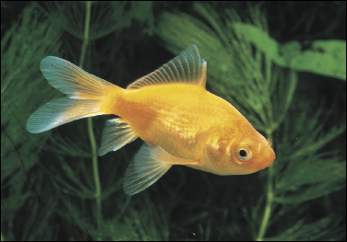
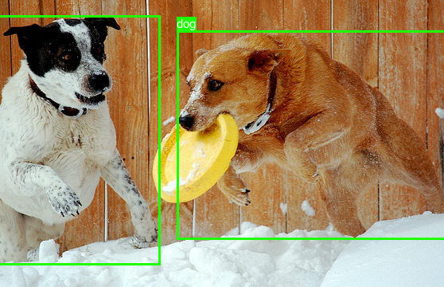
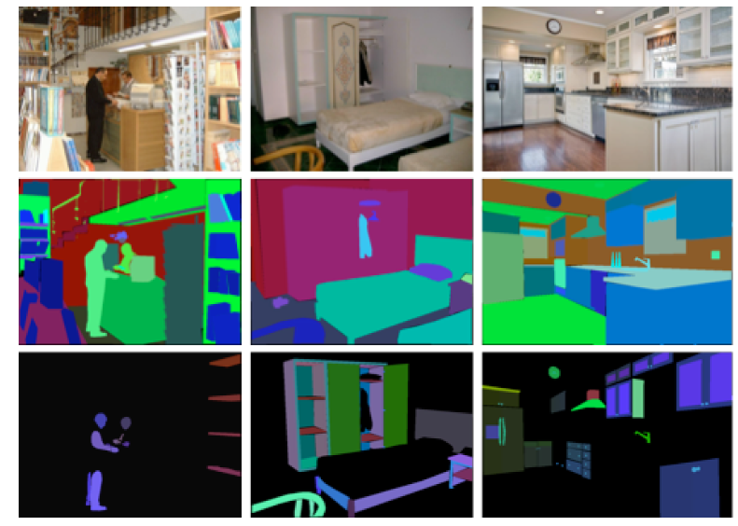
MiDaS Datasets
Dataset | Description | Vision Task | Train | Validation | Test | Link
ImageNet-1k | The ImageNet dataset is a large, diverse collection of annotated images used for image classification tasks | Classification | 1.28M | 50k | 100k | Link
COCO | COCO is a large-scale object detection, segmentation, and captioning dataset | Object Detection | 118k | 5k | 20k | Link
ADE20K | Comprehensive dataset for semantic segmentation and scene parsing tasks | Semantic Segmentation | 20k | 2k | 3k | Link
ImageNet-1k
COCO
ADE20k
n01443537_goldfish.JPEG

Slide 21
Image Classification on ImageNet-1K
Settings:
Training on ImageNet-1K:
Optimizer: AdamW
Epochs: 300 with cosine decay learning rate
Warm-up: 20 epochs linear
Batch size: 1024
Initial learning rate: 0.001
Weight decay: 0.05
Pre-training on ImageNet-22K and fine-tuning on ImageNet-1K:
Optimizer: AdamW
Pre-training: 90 epochs, fine-tuning: 30 epochs
Batch size: Pre-training 4096, fine-tuning 1024
Learning rate: 0.001 for pre-training, 10^-5 for fine-tuning
Weight decay: 0.01 for pre-training, 10^-8 for fine-tuning

Slide 22
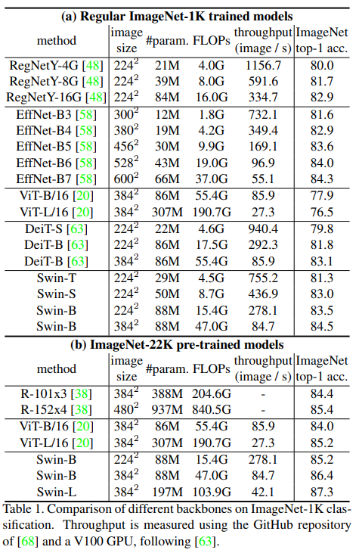
Image Classification on ImageNet-1K
Results:
Comparisons with other backbones:
Swin-T vs. DeiT-S: +1.5 top-1 acc. (81.3 vs. 79.8 top-1 acc.) using 224x224 input
Swin-B vs. DeiT-B: +1.5 top-1 acc. /1.4 top-1 acc. (83.3/84.5 top-1 acc. vs. 81.8/83.1 top-1 acc. ) using
224x224/384x384 input
Swin-T vs. RegNetY-8G: -0.4 top-1 acc. (81.3 vs. 81.7 top-1 acc.) using 224x224 input
Swin-T vs. EffNet-B3: -0.3 top-1 acc. (81.3 vs. 81.6 top-1 acc.) using 224x224 input
ImageNet-22K Pre-training Results:
Swin-B: 86.4 top-1 accuracy (+2.4 top-1 acc. higher than ViT-B/16 and +2 top-1 acc. higher than R-101x3)
Swin-L: 87.3 top-1 accuracy (+2.1 top-1 acc. better than ViT-L/16 and +2.9 top-1 acc. higher than R-101x3)

Slide 23
Object Detection on COCO
Settings:
Models Evaluated:
Faster R-CNN
Mask R-CNN
Cascade Mask R-CNN
Training Configuration:
Backbone: Swin-T, Swin-B, Swin-L
Optimizer: AdamW
Learning Rate Schedule: Cosine decay
Batch Size: 16
Epochs: 36 (3x schedule)

Slide 24
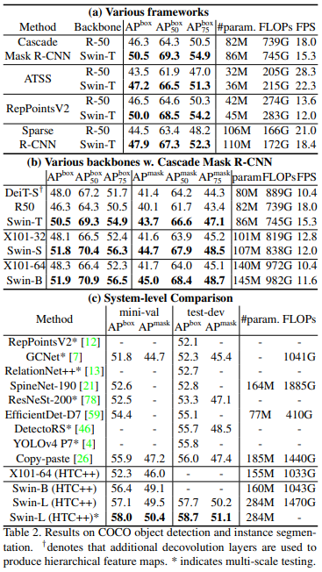
Object Detection on COCO
Results:
Swin-T vs. ResNet-50:
Achieves +3.4 to 4.2 box AP gains over ResNet-50.
Comparison with Other Backbones:
ResNet-50 (R-50):
Swin-T achieves +4.2 box AP over ResNet-50.
DeiT-S:
Swin-T achieves +2.5 box AP over DeiT-S.
ResNeXt101-32:
Swin-S shows +3.7 box AP over ResNeXt101-32.
ResNeXt101-64:
Swin-B shows +3.6 box AP over ResNeXt101-64.

Slide 25
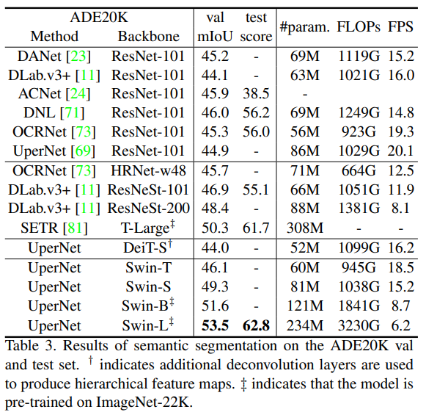
Semantic Segmentation on ADE20K
Settings:
Dataset: ADE20K
Base Framework: UperNet
Results:
Swin-S
Achieves 49.3 mIoU, which is +5.3 mIoU higher than
DeiT-S (44.0) with similar computation cost.
Outperforms ResNet-101 by +4.4 mIoU.
Outperforms ResNeSt-101 by +2.4 mIoU.
Swin-L:
With ImageNet-22K pre-training, achieves 53.5 mIoU
on the validation set.
Surpasses the previous best model (SETR)
by +3.2 mIoU, which had 50.3 mIoU with a
larger model size.

Slide 26
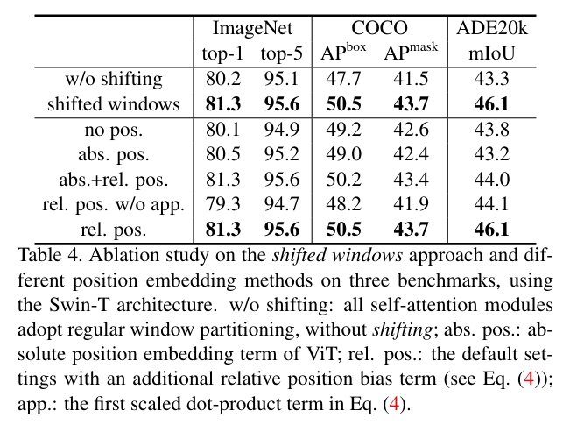
Ablation Studies
Importance of Shifted Windows:
Comparison with single window partitioning shows:
+1.1% top-1 accuracy on ImageNet-1K
+2.8 box AP and +2.2 mask AP on COCO
+2.8 mIoU on ADE20K
Effect of Relative Position Bias:
Improves performance across all tasks:
+1.2%/+0.8% top-1 accuracy on ImageNet-1K
+1.3/+1.5 box AP and +1.1/+1.3 mask AP on COCO
+2.3/+2.9 mIoU on ADE20K

Slide 27

Conclusions
Summary:
Introduced a hierarchical vision Transformer using shifted windows.
Addressed limitations of standard ViTs by incorporating hierarchical feature maps and shifted windows.
Achieves linear computational complexity with respect to input image size.
Outperforms previous methods in COCO object detection and ADE20K semantic segmentation.
Key Innovations:
Shifted Window Mechanism: Effective and efficient for vision tasks.
Hierarchical Feature Maps: Enables efficient computation and better handling of high-resolution images.
Relative Position Bias: Enhances spatial understanding and performance.

Slide 28
Future Directions
Optimization: Further research into more efficient training methods and architectures.
Applications: Explore the use of shifted window-based self-attention in NLP.
Integration: Combining Swin Transformers with other models and techniques for enhanced performance.

Slide 29
End
Thanks for listening!

